Slide 1
Sisteme de scanare 3D
Car Hood — from 3D Scan to Solid Model (Capota masina)
CATIA V5 · Digitized Shape Editor · Quick Surface Reconstruction · Part Design
Part: Capota_masina_1.stl Name: Vaida Diana-Laura

Slide 2
Overview & Workflow
Goal: rebuild a clean parametric solid model of the hood panel from its 3D scan mesh, then verify accuracy against the scan.
1
Import mesh
2
Inspect / clean
3
Align to planes
Load the STL into Digitized Shape Editor
Check the mesh — no defects, no cleaning needed
Rotate flat + center; symmetry plane on yz
4
Build curves
5
Create surface
6
Make solid
3D Curves traced on the mesh surface
Multi-Section Surface through the curves
Thick Surface (1 mm) → solid body
7
Deviation check
Compare surface vs scan: max ≈ 0.5 mm
Commands deliberately avoided (not allowed): Power Fit · Automatic Surface · Curve on Mesh
Notes:
Introduce the part: a car hood scanned as an open single-skin mesh, ~1236 x 551 mm, 287k triangles. Explain the goal in one sentence: turn the messy scan into a clean parametric solid, then prove it matches. Point out the 7-step workflow and stress you used only allowed commands — no Power Fit, Automatic Surface, or Curve on Mesh.

Slide 3
1
Importing the Mesh
What I did
Switched to Digitized Shape Editor
Insert > Import, format STL, units mm
Scan imported at correct real-world size (~1236 mm long)
Mesh appears as a feature in the specification tree
Commands used
Start > Shape > Digitized Shape Editor → Insert > Import
Notes:
Show the imported hood at correct scale and the mesh node in the tree. Mention units were set to mm so the part came in life-size. This is the 1-point import step.

Slide 4
2
Mesh Inspection — No Cleaning Needed
What I did
Inspected the mesh for defects before surfacing
Single connected body — no floating/stray triangles
No non-manifold edges, no duplicate or degenerate faces
Open outer boundary is expected (single-skin panel)
Conclusion: no cleaning required → budget folds into surfaces
Commands used
Visual inspection (Mesh tools available if needed)
Notes:
State clearly: you checked the mesh and it had no defects, so cleaning was not applicable. Per the rubric, that point is added to the surfaces score. Note the bumps near the edge are real panel features, not noise.

Slide 5
3
Aligning the Mesh to the Planes
What I did
Goal: place the panel logically on the system planes
Rotated 40° about the Y axis to lay the panel flat
Translated by (-24, -10, +127) mm to center on the origin
Symmetry plane aligned to the yz plane
Kept only the final transformed mesh visible (hid intermediates)
Commands used
Insert > Transformations > Rotate, then Translate
Notes:
Explain the two corrections: a roll about the long (Y) axis to lay it flat, then a translation to center it so the symmetry plane lands on yz. Mention each transform creates a new mesh, so you hid the intermediate ones. This is the 1-point alignment step.

Slide 6
4
Building the Curve Network
What I did
Built a wireframe network directly on the mesh
3D Curve, 'Through points', geometry detection ON (snaps to mesh)
Several section curves crossing the panel
Guide curves running lengthwise
Manual, controllable route — avoids the forbidden commands
Commands used
Insert > Curve Creation > 3D Curve
Notes:
Explain why curves first: a surface needs a skeleton of curves to follow. You traced points that snap onto the mesh. Emphasize this manual route respects the ban on Power Fit / Automatic Surface / Curve on Mesh.

Slide 7
5
Creating the Surface
What I did
Lofted a surface through the section curves in order
Sections: the cross curves; guides: the lengthwise curves
Checked section directions to avoid twisting
Result: one continuous skin following the panel shape
Clean, readable part tree (curves → surface)
Commands used
Insert > Surface Creation > Multi-Section Surface
Notes:
This is the biggest scoring step. Show the surface following the hood. Be honest: it is smooth over the main panel with minor waviness and does not fully reach the edges. Stress the tidy tree and that only allowed commands were used.

Slide 8
6
Creating the Solid Body
What I did
Switched to Part Design
Applied Thick Surface to the Multi-Section Surface
Thickness = 1 mm (assumed — single-skin scan, realistic hood gauge)
Result: a solid body, ThickSurface.1, in the tree
Commands used
Part Design > Insert > Surface-Based Features > Thick Surface
Notes:
Explain the thickness was chosen (~1 mm) because the scan is a single skin with no measurable wall, and 1 mm is realistic for a hood outer panel. This is the 1-point solid step. Note: no holes on this panel, so the Hole/operations point folds into surfaces.

Slide 9
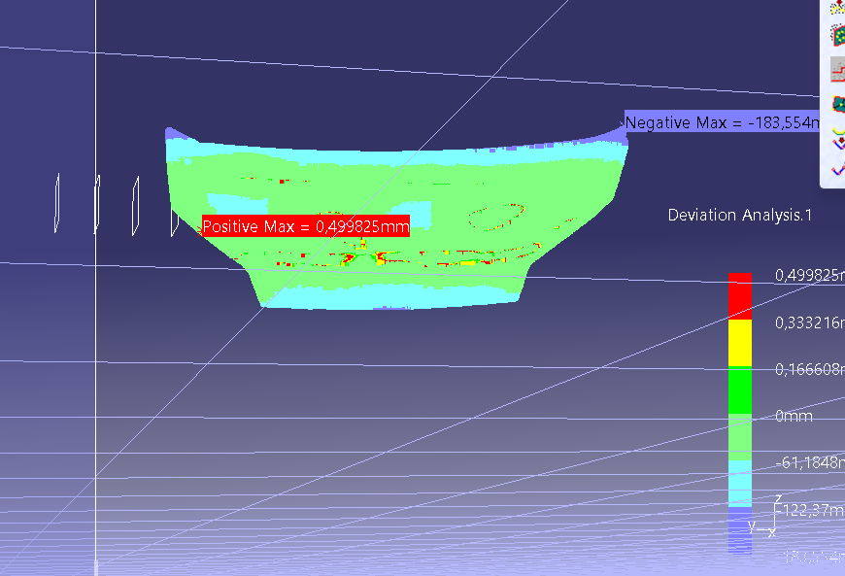
7
Deviation Analysis
What I did
Compared the final surface/solid against the scan mesh
Reference: ThickSurface.1 · To measure: aligned mesh
Most of the panel is green ≈ 0 mm (close match)
Positive max ≈ 0.50 mm on the main panel
Larger deviation only at edges / feature lines
PASTE YOUR SCREENSHOT HERE
CATIA: the color deviation map + scale (Positive Max ≈ 0.50 mm)
Commands used
DSE: Insert > Analysis > Deviation Analysis
Notes:
Read the result honestly: the main panel matches within about half a millimetre (green), with larger errors only at the trimmed edges where the simplified surface does not fully follow the scan. This is the 1-point deviation step.

Slide 10
Result & Deliverables
A complete parametric solid of the hood, rebuilt from the scan using only permitted commands.
Import
Alignment
✓
✓
Mesh imported in DSE
Flat & centered, symmetry on yz
Surface
Solid
✓
✓
Multi-Section Surface, clean tree, allowed commands only
Thick Surface, 1 mm
Deviation
Files
✓
✓
Main panel within ≈ 0.5 mm of the scan
Upload .CATPart + this presentation
Thank you
Notes:
Wrap up: every grading step is covered — import, alignment, surfaces (allowed commands, clean tree), solid, deviation. Be honest that the surface is a good approximation (within ~0.5 mm on the main panel) rather than a perfect Class-A surface. Remember to upload BOTH the .CATPart and this presentation to the Assignment.

